Slide 1
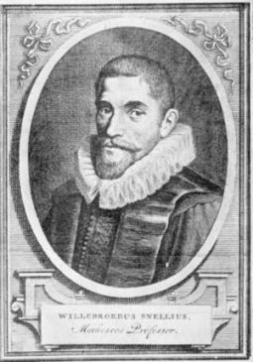
Refraction and Snell’s Law
Reading - Shen and Kong – Ch. 4
Outline
TE and TM fields
Refraction and Snell’s Law:
- From TE analysis
- From Phase Matching
- From Fermat’s Principle of Least Time
Total Internal Reflection and Fibers
FIOS
Image in the Public Domain
Willebrord Snellius
(1580–1626) was a
Dutch astronomer and mathematician

Slide 2
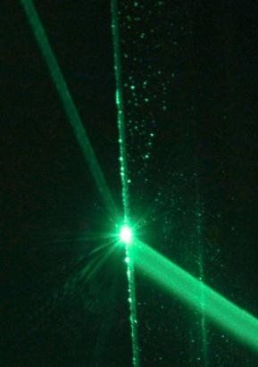
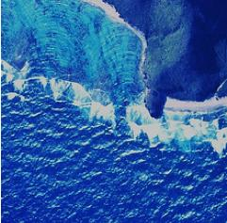
Refraction
Water Waves
E&M Waves
Image by NOAA Photo library http://www.flickr.com/photos/noaaphotolib/5179052751/ on flickr
Waves refract at the top where the water is shallower
Refraction involves a change in the direction of wave propagation due to a change in propagation speed. It involves the oblique incidence of waves on media boundaries, and hence wave propagation in at least two dimensions.

Slide 3


Oblique Incidence at Dielectric Interface
H_{r}
E_{t}
E_{r}
Transverse
Electric Field
E_{i}
H_{t}
H_{i}
H_{r}
E_{t}
E_{r}
Transverse
Magnetic Field
H_{t}
E_{i}
H_{i}
y
•

Slide 4
Partial TE Analysis
H_{r}
z = 0
E_{t}
E_{r}
H_{t}
E_{i}
H_{i}
y
•
Tangential E must be continuous at the boundary z = 0 for all x and for t.
This is possible if and only if and
The former condition is phase matching

Slide 5



Snell’s Law
•
SNELL’S LAW

Slide 6

Snells Law via Phase Matching
θ_{i}
λ₁
L
λ₂
θ_{t}
Following phase continuity, the phase-front separation L is common to both the incident and transmitted, or refracted, waves.

Slide 7
Snell’s Law Diagram
Tangential E field
is continuous …

Slide 8

Refraction in Suburbia
Think of refraction as a pair of wheels on an axle going from a sidewalk onto grass. The wheel in the grass moves slower,
so the direction of the wheel pair changes.
Note that the wheels
move faster (longer space)
on the sidewalk, and slower
(shorter space) in the grass.
Notes:
8

Slide 9
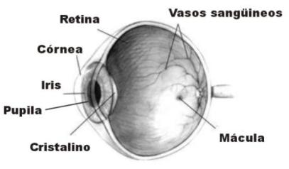
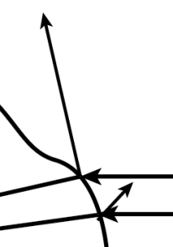
Snell’s Law and Lenses
Image in the Public Domain
Surface
Normal
Bend towards normal
Bend
away from normal
glass

Slide 10
History of Snell’s Law
Snell’s Law describing refraction was first recorded by Ptolemy in 140 A.D
First described by relationship by Snellius in 1621
First explained in 1650 by Fermat’s principle of least time.
EXAMPLES:
BEAM OF LIGHT IS OFFSET AS IT PASSES THROUGH A TRANSPARENT BLOCK
FOCUSING OPTICAL SYSTEM
To apparent sun
Atmosphere
Light from sky
Light path
To true sun
Hot road or sand
Earth
MIRAGE
NEAR THE HORIZON, THE APPARENT SUN IS HIGHER THAN THE TRUE SUN BY ABOUT ½ DEGREE

Slide 11
Fermat’s Principle of Least Time
Fermat’s principle of minimum time argues that light will travel from one point to another along a path that requires the minimum time.
Applied to Reflection
•
•
A
B
B’
•
Since it is straight, the blue path is the shortest path from A to B’. So, the blue path is also the shortest reflecting path to B since it images the path to B’. For the blue path, the incidence and reflection angles equal.

Slide 12
Fermat’s Principle of Least Time
Refraction
A
•
•
B
The time require for light to travel from A to B is given by
From , it follows that

Slide 13
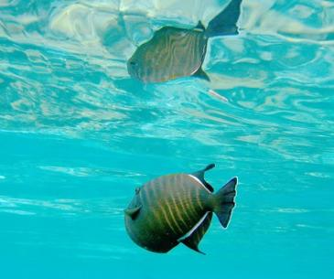
Total Internal Reflection
Beyond the critical angle, , a ray within the higher index medium cannot escape at shallower angles
For glass, the critical internal angle is 42°
For water, it is 49°
TOTAL INTERNAL REFLECTION
Image is in the public domain
INCOMING RAY HUGS SURFACE
42°

Slide 14
Snell’s Law Diagram
Tangential E field is continuous …
Refraction
Total Internal Reflection

Slide 15
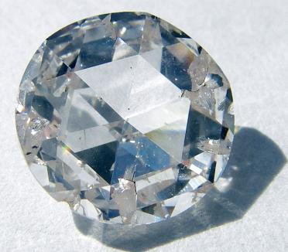
Applications of Total Internal Reflection
Critical angle (diamond/air interface): sin⁻¹(n₂/n₁) = sin⁻¹(1/2.42) ~ 24°
Critical angle (glass/air interface) is: ~ 42°
Critical
Angle
Image by Steve Jurvetson
http://en.wikipedia.org/wiki/File:Apollo_synthetic_diamond.jpg on Wikipedia
Diamonds sparkle as light bounces inside them
multiple times due to the high index of refraction

Slide 16
Total Internal Reflection in Suburbia
Moreover, this wheel analogy is mathematically equivalent to the refraction phenomenon.
One can recover Snell’s law from it: n₁ sin θ₁ = n₂ sin θ₂ .
The upper wheel hits the sidewalk and starts to go faster, which turns the axle until the upper wheel re-enters the grass and wheel pair goes straight again

Slide 17


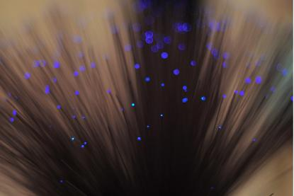
Waveguide Transports Light Between Mirrors
Metal waveguides
Dielectric waveguides
So what kind of waveguide are the optical fibers ?
Image by Dan Tentler http://www.flickr.com/
photos/vissago/4634464205/ on flickr

Slide 18
Optical Fibers
Light Propagating Through
A Multimode Optical Fiber
Single Mode Fiber Structure
cladding
Jacket
400 μm
core
Buffer
250 μm
Acceptance
angle
Cladding
125 μm
Index of refraction
Input pulse
Core
8 μm
125 μm
200 μm
Step Index Fiber
Modal dispersion is a distortion mechanism occurring in multimode fibers and other waveguides, in which the signal is spread in time because the propagation velocity of the optical signal is not the same for all modes
125 μm
50-100 μm
Graded Index Fiber
125 μm
10 μm
Singlemode Fiber

Slide 19

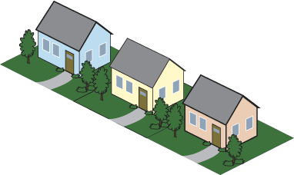

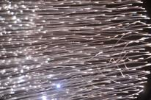
Fiber to the Home
Time Division Multiplexing
2.4 Gbps shared by up to 128 users
Small Businesses
10-100 Mbps service rates
ONT
Splitter
2
3
Splitter
ONT
ONT
2.4 Gbps out
1.2 Gbps in
ONT
4
Splitter
ONT
3
ONT
2
ONT
1
1
20 km reach
Splitter
ONT
OLT
(located in Verizon's central switching office)
4
An ONT (Optical Network Terminal) is a media converter that is installed by Verizon either outside or inside your premises, during FiOS installation. The ONT converts fiber-optic light signals to copper/electric signals. Three wavelengths of light are used between the ONT and the OLT (Optical Line Terminal):
• λ = 1310 nm voice/data transmit
• λ = 1490 nm voice/data receive
• λ = 1550 nm video receive
Each ONT is capable of delivering:
Multiple POTS (plain old telephone service) lines, Internet data, Video
Image by Raj from Chennai, India
http://commons.wikimedia.org/
wiki/File:Strings_of_lights.jpg
on Wikimedia Commons

Slide 20
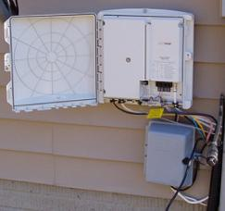
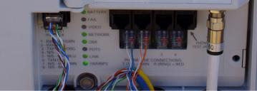



Fiber to the Home
Image by uuzinger http://www.flickr.com/photos/uuzinger/411425461/ on flickr
Image by uuzinger http://www.flickr.com/photos/uuzinger/411425452/on flickr
Bandwidths & Services
POTS
Upstream
Downstream
ONT
1310 nm
1490 nm
1550 nm
Data
Voice and Data
Voice and Data
Video
ONT
Video
Channels downstream to each home
  λ = 1490 and λ = 1550 nm
Channel upstream from each home
  λ = 1310 nm
Power &
Battery
Image of ONT by Josh Bancroft http://www.flickr.com/photos/joshb/87167324/ on flickr

Slide 21
Passive Optical Network (PON)
Optical Assembly
TO Can Laser
TO Can PINS
Single mode
fiber
Ball lens
Thin film filters
Upstream
Downstream
Channels downstream to each home
  λ = 1490 and λ = 1550 nm
Channel upstream from each home
  λ = 1310 nm
Transmission
1310
1490
1550
Wavelength (nm)

Slide 22


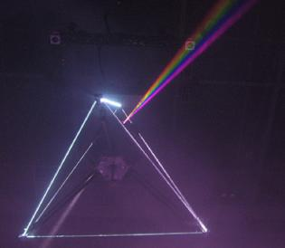

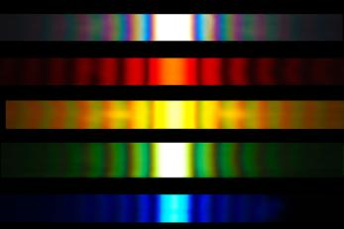

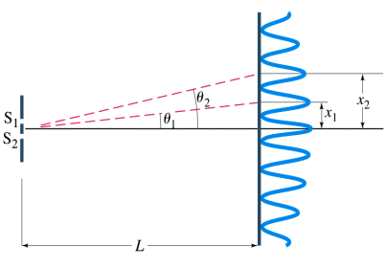
Separating Wavelengths
Dispersion
Diffraction
Image by Ian Mackenzie http://www.flickr.com/photos/madmack/136237003/
on flickr
Sunlight diffracted through a 20 μm slit
Image is in the public domain
Image by wonker http://www.flickr.com/photos/wonker/2505350820/ on flickr

Slide 23
Fabry-Perot Resonance
Transmission
Wavelength [μm]
Fabry-Perot Resonance: maximum transmission
minimum transmission

Slide 24
Flexible Membrane
General concept of a
MEMS Fabry-Perot filter
formed on a detector
(by applying voltage between the top and bottom mirror the distance L between the mirrors can be adjusted)
Membrane
Support
Top Mirror
Bottom Mirror
Silicon
Readout
Detector
General concept of a
Mach-Zehnder Modulator
(phase shifters change the phase of the light beam in one of the waveguide arms with respect to the other beam, so that they can constructively or destructively interfere)
Phase Shifter
Light out
Light in
Phase Shifter

Slide 25
MIT OpenCourseWare
http://ocw.mit.edu
6.007 Electromagnetic Energy: From Motors to Lasers
Spring 2011
For information about citing these materials or our Terms of Use, visit: http://ocw.mit.edu/terms.

